Slide 1
TEAM 5 - KSUGo
ALBERT LIM
CHASE GODWIN
PATRICK HILERIO
DAYTON CHAMBERLIN
ANTHONY SCHELL
NICK WILSON

Slide 2

TEAM QUALIFICATION
Albert Lim
Chase Godwin
Patrick Hilerio
Dayton Chamberlain
Anthony Schell
Nick Wilson
Java
C++
MySQL
MongoDB
Angular
Node.JS
ROLE
Team Leader
Prototype/ UI design
Feature developer
Java
C++
Git
REST
MySQL
HTML
CSS
ROLE
Feature/ Network developer
Backend design
Java/JavaFX
C++
MySQL
HTML
CSS
PHP
ROLE
Prototype
UI creation
Back-end developer
C++
Java
MySQL
R
HTML
CSS
JavaScript
ROLE
Design UI
Backend feature developer
Java
C++
SQL
Ruby on Rails
HTML
CSS
JavaScript
ROLE
Prototype/UI creation
Front end developer
Java
C++
MySQL
HTML
CSS
JavaScript
Django
ROLE
Backend developer
Database administrator

Slide 3


WHY KSUGo?
The purpose of this project is to deliver a mobile app that is focused on improving the student experience at KSU. We want more students to be engaged and active as part of KSU communities, as well as making sure that KSU students are aware of resources and facilities that are available to them.

Slide 4

PROBLEM STATEMENT
The ability to effectively and efficiently navigate Kennesaw State University resources via mobile application is unavailable to students and faculty, with little access to campus information in one convenient location. KSU contains a plethora of significant data that individuals may use daily, but is cumbersome to access, or presented poorly; the implementation of one central hub based in a mobile environment would solve these problems, and allow for greater involvement of all parties interacting with KSU.
Students, teachers, and faculty unable to easily utilize extent of KSU resources on a day-to-day basis, or must explore multiple outlets to get the features that they are looking for.

Slide 5

PROPOSED SOLUTION
The driving objective behind this project is to improve the student experience through a user friendly mobile app. Part of the problem with student involvement is poor communication of relevant information, and this app will be focused at presenting this in a visually pleasing, easy to access manner.
We are going to create an app called KSUGo. It will be initially available to Android users and feature information about the campus, such as a campus directory, a link to emergency services, D2L, Owl Life (clubs and organizations), Handshake (career planning), social feeds, easy to access student schedule, campus map, and BOB (KSU bus) route tracking.

Slide 6
ACCESSIBILITY & USABILITY
As mentioned before, a great significance of the application is placed not only on the students, but the faculty. Levels of accessibility will be available based on the user’s status in regard to KSU, with teachers having different tools to utilize relative to certain applications. The ability to set events, announcements, or points of interest on the interactive map will be allowed for teachers and other faculty, with students for their specific class being able to view and interact with such marks.
Along with the explained features, KSUGo is expected to contain functions for campus safety, and to be used on either the Marietta or Kennesaw Campus. Interactive features such as maps or transportation location are intended to be updated such that users are always equipped with current information across either campus. The flow of the application should allow each individual to actively utilize its features during their day at KSU.

Slide 7


TECHNICAL INFORMATION
KSUGo will be mainly developed in Android Studio. The team will use this powerful tool to bring KSU Go to life. The backend will be coded in Java. For the database we will be using SQLite in order to get and send information.
Implementations from external parties such as D2l access, BOB tracking in real time, and fully interactive mapping are contingent upon UITS and availability, but will be included as part of the app to the greatest extent possible .

Slide 8

PERFORMANCE EVALUATION
Android Studio has a built in Android Profiler which allows for real time monitoring of app performance data such as CPU, Memory, and Network Activity. Using this and “real life” tests of how the app affects battery life on our sample Android devices, we can accurately determine if our app is efficient.

Slide 9


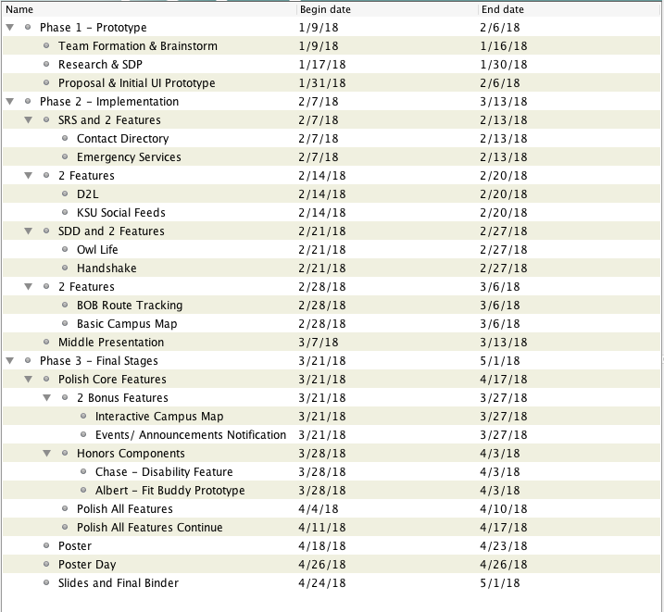
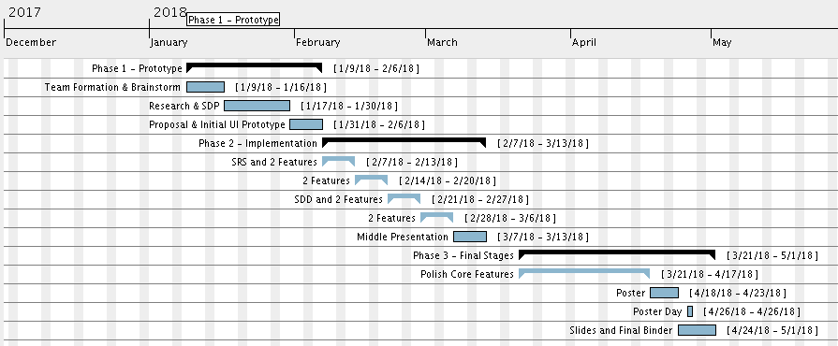
TIMELINE

Slide 10
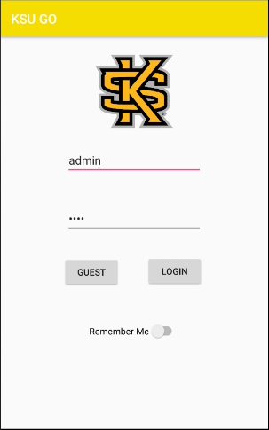
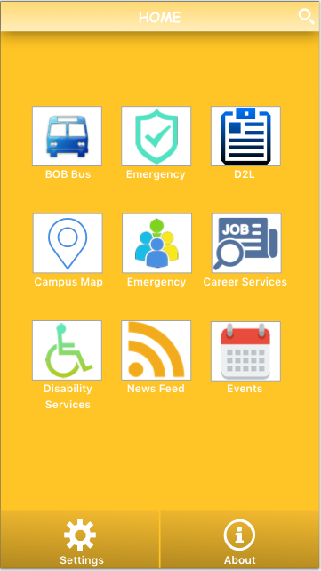
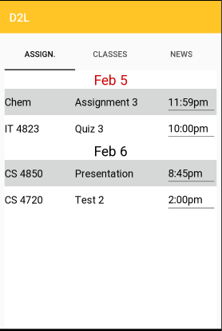
CURRENT DESIGNS

Slide 11


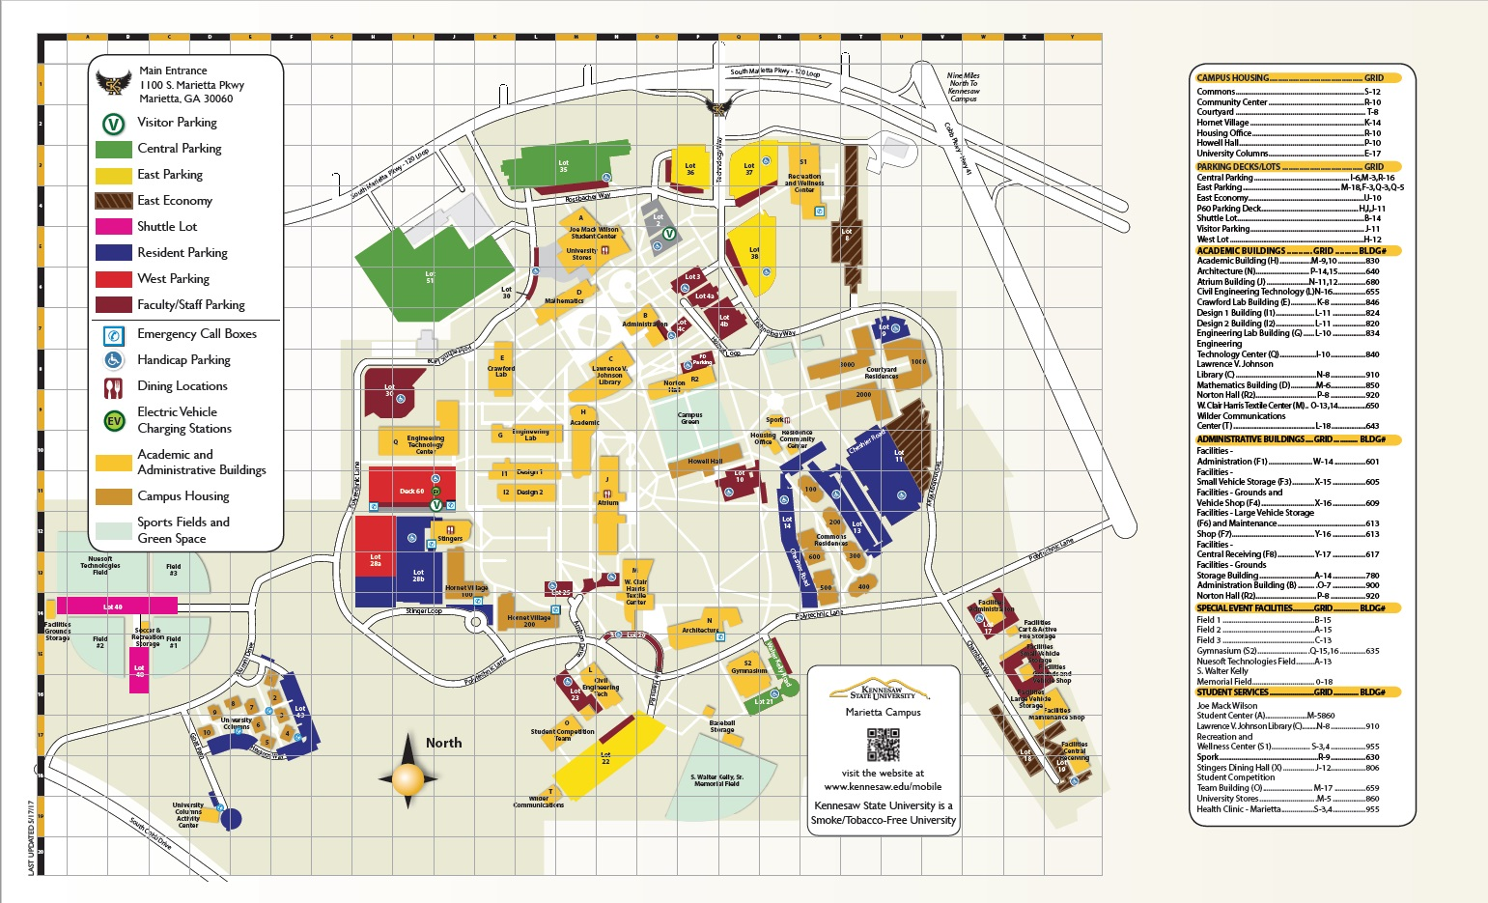
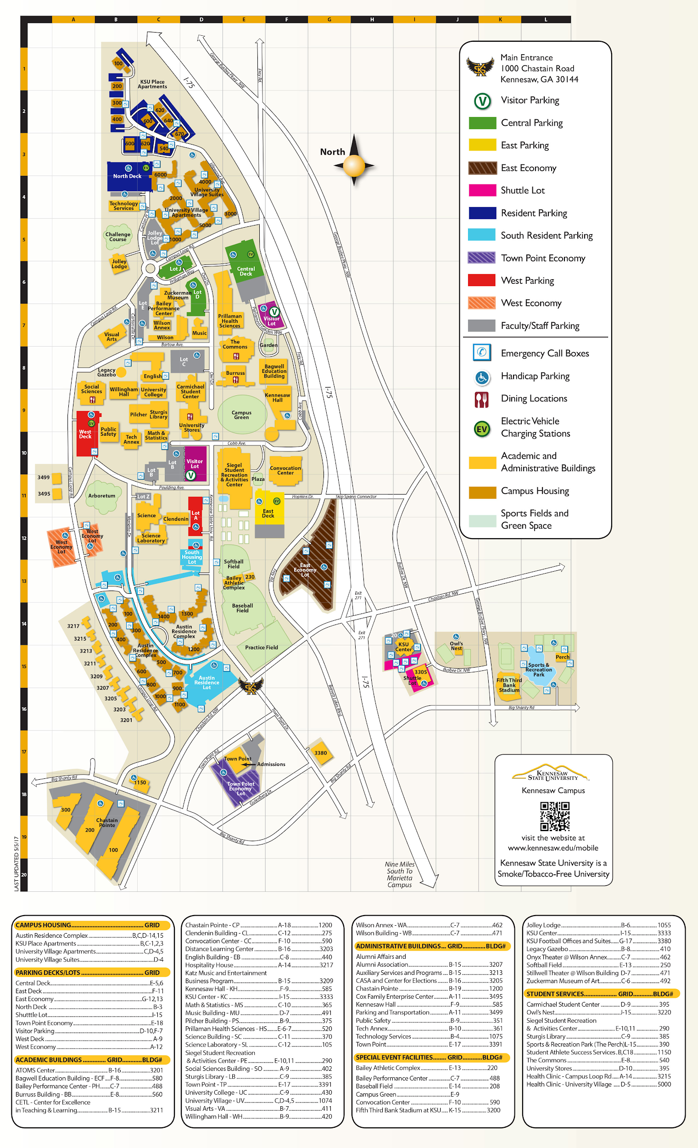
FEATURES
D2L
Student Schedule
BOB
OwlLife
Interactive Map
KSU Social Feeds
Handshake

Slide 12
REFERENCES
Android Studio & SQLite -
https://developer.android.com/studio/index.html
https://www.sqlite.org/releaselog/3_22_0.html
Google Maps Android API Help -
https://developers.google.com/maps/documentation/android-api/start
https://www.androidtutorialpoint.com/intermediate/android-map-app-showing-current-location-android/
Android Studio Research & Troubleshooting -
http://www.c-sharpcorner.com/article/how-to-be-working-with-multiple-activities-and-navigate-the-activities-in-androi/
https://developer.android.com/training/basics/firstapp/starting-activity.html
https://developer.android.com/training/basics/firstapp/running-app.html
https://developer.android.com/training/keyboard-input/commands.html
https://stackoverflow.com/questions/11531845/how-to-go-about-creating-an-interactive-map-in-android

Slide 13

QUESTIONS

